Slide 1
Question 25
Dario Bassi, Victor Ziegler, Chanae Smith

Slide 2
Question 25
1
INTRODUCTION

Slide 3
The dataset glass lists 9 parameters of different glass types:
ri
Refractive index
na2o
k2o
Sodium oxide
Potassium oxide
cao
k2o
mgo
cao
mgo
Magnesium oxide
ri
Calcium oxide
na2o
sio2
al2o3
bao
bao
Aluminium oxide
fe2o3
Barium oxide
al2o3
sio2
fe2o3
Silicon oxide
Iron oxide
Notes:
Dataset with glass samples
Metal oxides + the refractive index, which can be influenced by the presence of these metal oxides the glass.

Slide 4
The glass type can take one of three values:
GLASS
1
2
3
float
nonfloat
nonwindow
float processed window glass
non-float processed window glass
Non-window glass

Slide 5
Question 25
1
INTRODUCTION
2
PART A

Slide 6
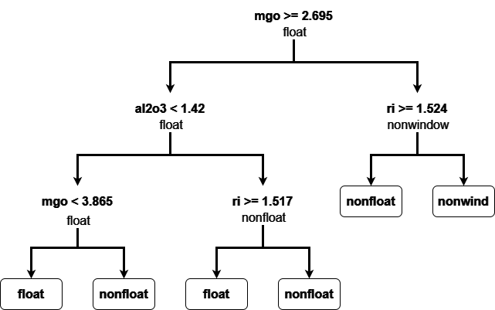
CART fitted to the glass data set: Full
Notes:
Classification and Regression Trees (CART) are a specific type of tree model that can be used for predicting categorical targets (classification) or continuous targets (regression).

Slide 7
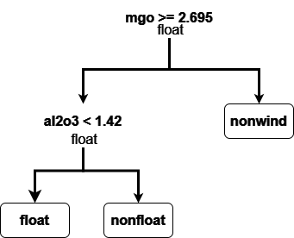
CART fitted to the glass data set: Pruned
Notes:
Pruned tree, in which the size of the tree has been reduced by removing branches that have little power in classifying instances. The goal is to improve the tree's ability to generalize to unseen data by reducing overfitting.

Slide 8
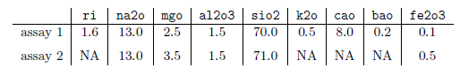
In a laboratory, the following properties of two glass assays are measured:
How would these assays be classified by the full tree and the pruned tree from the plot above?

Slide 9
Anatomy of a Tree
Root node
Branch / Sub-tree
Decision node
Leaf node / Terminal node
Classification label / Target value
Notes:
- Decision trees split data based on feature values to create homogeneous groups.
- The root node is the topmost node, which represents the initial condition
- Intermediate nodes split data based on conditions. The conditions are based on a feature's value.
- Going left or right depends on whether the feature value meets this condition.
- Typically, < threshold means left to handle smaller values first.
- Helps maintain a consistent method for traversing the tree.
- Branches represent the outcomes of conditions, and sub-trees are self-explanatory
- Leaf Nodes are the final nodes which represent the classifications (e.g., float, nonfloat, nonwind).

Slide 10
ASSAY 1 - Full Tree
Go Left: If mgo < 2.695
Go Right: If mgo >= 2.695
Classification:
nonfloat

Slide 11
ASSAY 1 - Pruned Tree
Classification:
nonfloat

Slide 12
ASSAY 2 - Full Tree
Classification:
not a float

Slide 13
ASSAY 2 - Pruned Tree
Classification:
nonwindow

Slide 14
Question 25
1
INTRODUCTION
2
PART A
3
PART B

Slide 15
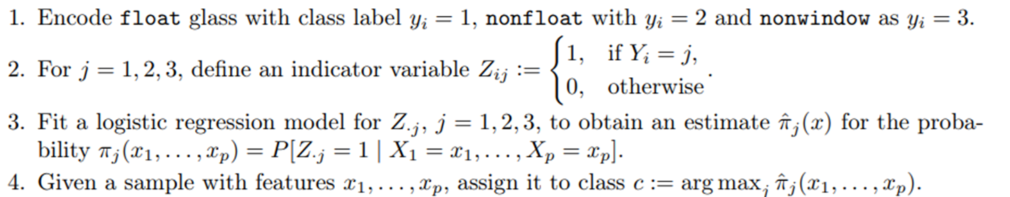
Logistic regression cannot be directly applied to the glass dataset with 3 classes. We therefore encode the 3 class problem with 3 binary classification problems:
The R output for the three logistic regressions of class j vs. the rest is shown in the following slides. Based on these outputs, which glass type would the two assays from a) be assigned to?

Slide 16
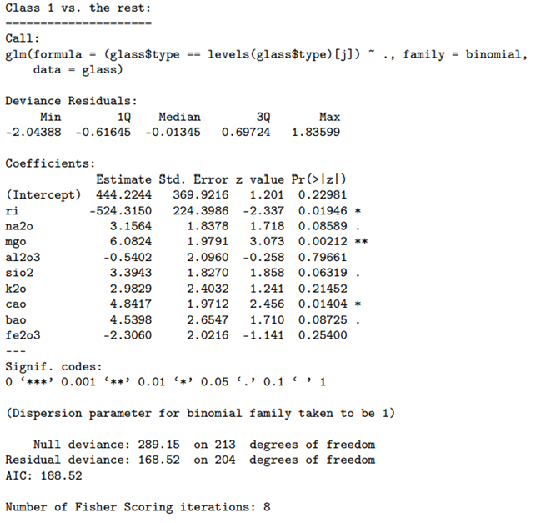

Slide 17
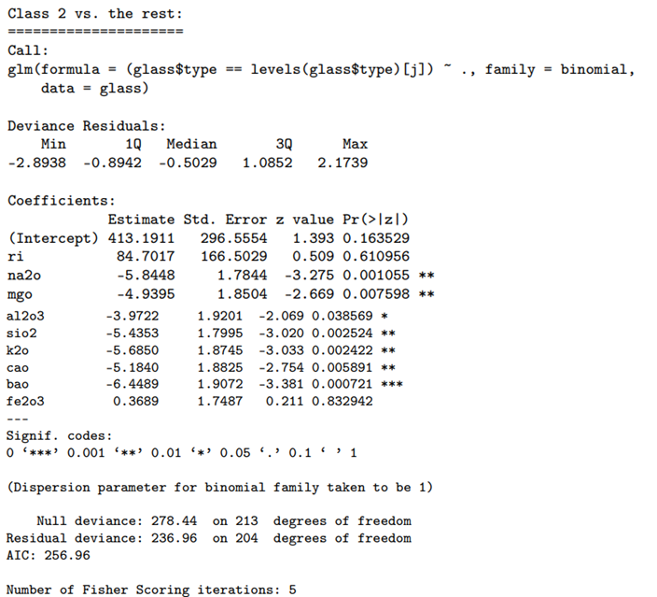

Slide 18
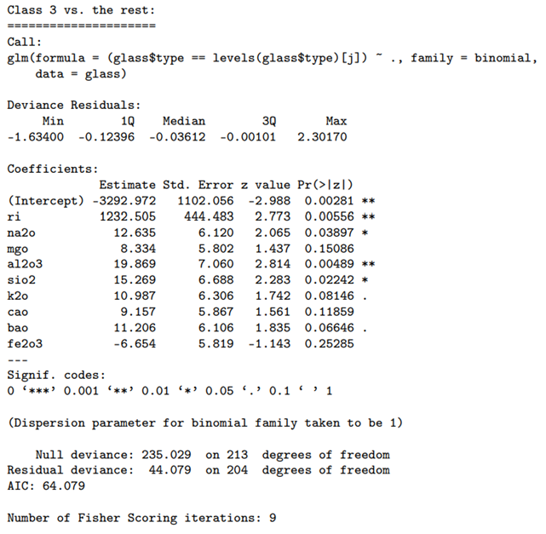

Slide 19
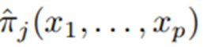
The logistic regression models for Z.j are already done. So we need to find out for which j the fitted posterior class probability will be maximal.

Slide 20
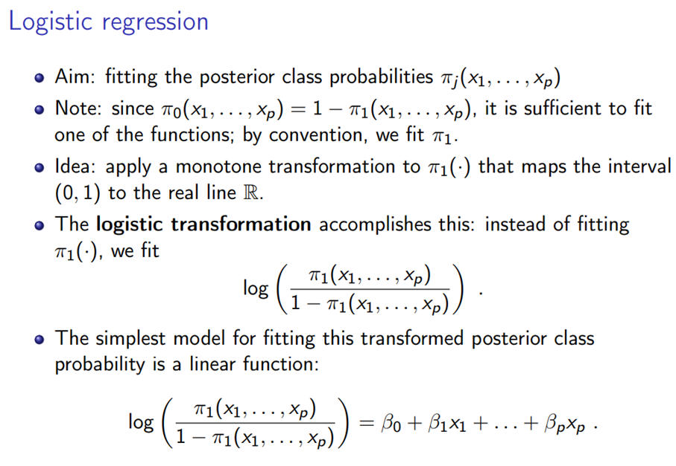

Slide 21
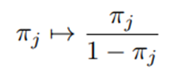
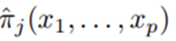
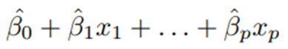
Logistic Transformation
Since the logistic transformation
is monotonically increasing, the glass type j with the maximal posterior probability is the one for which the right-hand side of the logistic regression model is maximized, i.e. the scalar product:

Slide 22
Scalar Products
*

Slide 23
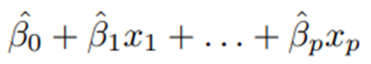
Assay 1 Classification
Classification:
nonwindow
j = 1 → float
= 444.2 - (524.3*1.6) + (3.2*13) + (6.1*2.5) - (0.5*1.5) +
(3.4*70) + (3*0.5) + (4.8*8) + (4.5*0.2) - (2.3*0.1)
= -60.74729
j = 2 → nonfloat
= 413.2 + (84.7*1.6) - (5.8*13) - (5*2.5) - (4*1.5) - (5.4*70) -
(5.6*0.5) - (5.2*8) - (6.4*0.2) + (0.4*0.1)
= 28.38523
j = 3 → nonwindow
= -3293 + (1232.5*1.6) + (12.6*13) + (8.3*2.5) + (19.9*1.5) +
(15.3*70) + (11*0.5) + (9.1*8) + (11.2*0.2) - (6.6*0.1)
= 43.0848

Slide 24
Why Different Classification Results for Assay 1 based on CART vs Logistic Regression?
CART Classification (Nonfloat):
Uses a hierarchical structure of binary decisions.
Splits data based on feature thresholds.
Result was nonfloat because the path taken based on feature values (mgo, al2o3, ri) led to the nonfloat class.
Logistic Regression Classification (Nonwindow):
- Uses a mathematical model to estimate probabilities of each class.
- Considers all features simultaneously.
- Calculates scores for each class and assigns the class with the highest score.
- Assay 1 was classified as nonwindow because the LR model estimated the highest probability for the nonwindow class based on the given coefficients and feature values.

Slide 25
Why Different Classification Results for Assay 1 based on CART vs Logistic Regression?
when classes are not well-separated, trees are susceptible to overfitting the training data, so that Logistic Regression’s simple linear/plane boundary generalizes better.

Slide 26
Assay 2 Classification
Recall that the parameters for Assay 2 contain missing values. As a result, a prediction is not possible since we cannot do the calculation.

Slide 27
Question 25
1
INTRODUCTION
2
PART A
3
PART B
4
DISCUSSION

Slide 28
Discussion
How do the missing values in Assay 2 affect the ability to make predictions using logistic regression and decision trees.
What can be done to handle missing data, and what are the pros and cons of these strategies?
How to determine that these coefficients are statistically significant but these are not? If it wasn't predefined there in question.
How would you ensure the robustness of your evaluation and what metrics you would use to compare their performance.

Slide 29
Missing Values
N.A.
9999
NaN

Slide 30
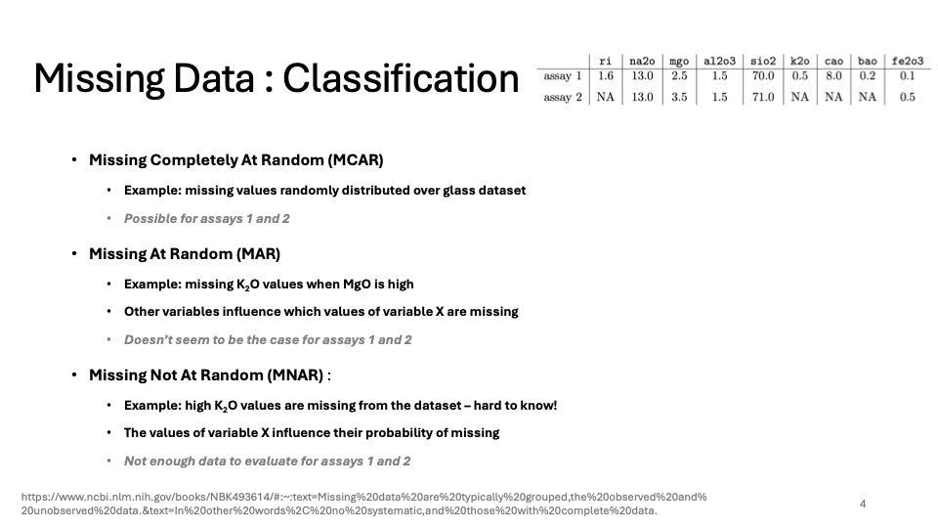

Slide 31
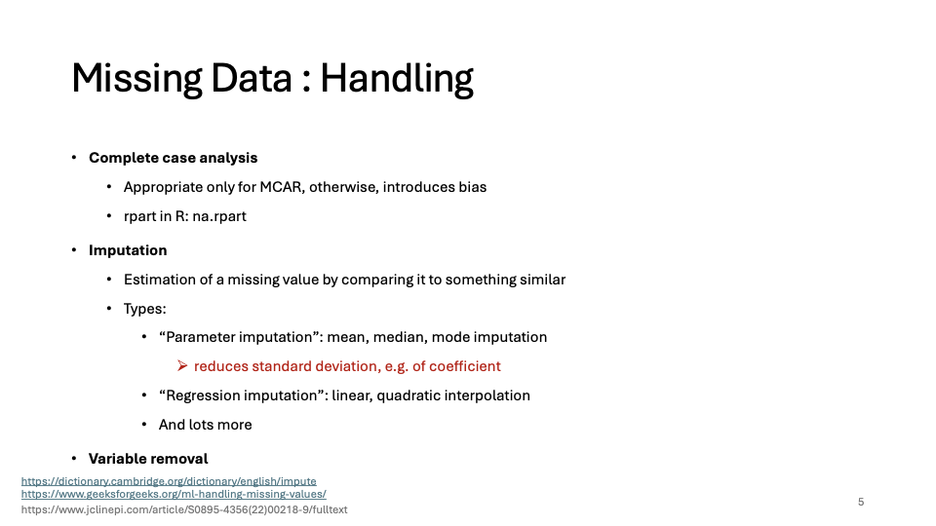

Slide 32
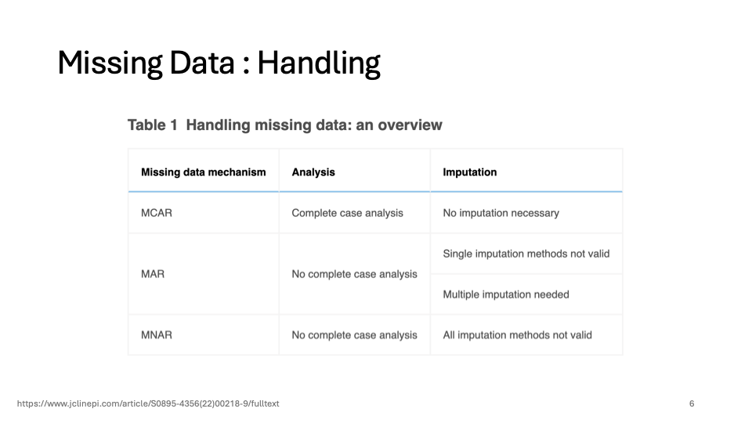

Slide 33
Thank You

Slide 34
Supplementary Slides

Slide 35
CART
Binary recursive partitioning algorithm
Classification trees → which “class” the target variable is most likely to fall into.
Regression trees → used to predict a continuous variable's value.
Feature and threshold for splitting are chosen to maximize the homogeneity of resulting subsets
Splitting continues until stopping rule is met.
Examples of rules: minimum number of observations in a node, a maximum depth of the tree, or a minimum improvement in the splitting criterion.
Notes:
CART is a binary recursive partitioning algorithm that splits the data into two subsets based on a single feature and a threshold value.
The feature and the threshold are chosen to maximize the homogeneity of the resulting subsets, which can be measured by different criteria depending on the type of the target variable.
The splitting process continues until a stopping rule is met, such as a minimum number of observations in a node, a maximum depth of the tree, or a minimum improvement in the splitting criterion.

Slide 36
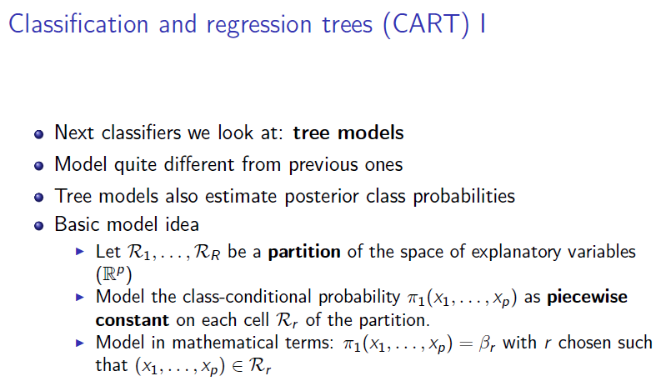
Notes:
The trees are formed by recursively partitioning the input space, and fitting a simple prediction model within each partition.
The partitions are represented as branches, and the final predictions as leaves.
The tree models estimate posterior class probabilities by:
Partitioning the space of explanatory variables into distinct regions. For classification, each region corresponds to a class predicted by the tree.
Modeling the class-conditional probability as constant within each region.

Slide 37
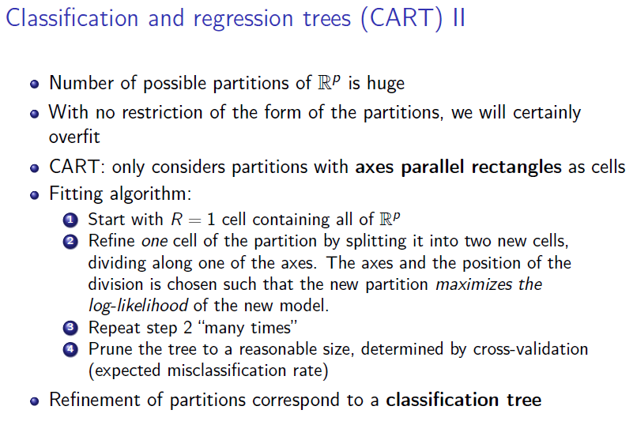
Notes:
Starting with a single region containing all data, it splits the data into two new regions based on one of the variables, creating two branches.
It selects the split that maximizes the log-likelihood of the model (or minimizes impurity in the context of classification).
It continues splitting each region recursively, forming a tree-like structure.
The process can result in overfitting, so typically the tree is pruned back using cross-validation to find a tree that generalizes well.

Slide 38
Splitting Criteria
CART uses a greedy approach to split the data at each node.
It evaluates all possible splits and selects the one that best reduces the impurity of the resulting subsets.
Classification tasks → Gini impurity, entropy
Gini impurity: measures the frequency at which any element of the dataset would be misclassified when randomly labeled according to the distribution of labels in the subset.
Lower Gini impurity = the more pure the subset is.
Regression tasks → mean squared error, mean absolute error.
Complexity parameter (rpart) → weighs the depth of the tree against the misclassification rate.

Slide 39
CART? Decision Tree?
Not interchangeable
CART = an algorithm that a decision tree uses to decide how/where to split a node into two or more sub-nodes.
Other algorithms that decision trees may use are
ID3
C4.5
CHAID
MARS
Different algorithms use different metrics for measuring the best decision.
Eg. CART uses the Gini Impurity while ID3 and C4.5 use Information gain.

Slide 40
Advantages of CART
Easy to interpret / explain
Can be visualized as a series of if-then rules that lead to an outcome.
The path can be followed from the root node to the leaf node.
Versatile / flexible for different types of data / tasks
Can handle both categorical and numerical features, as well as classification and regression problems, with the same algorithm.
Can handle missing values and outliers
Assigns them to the most appropriate node based on the available information.
Reduces the need for data preprocessing/imputation
Feature selection / variable importance analysis
Ranks the features based on their contribution to the splitting criterion

Slide 41
Disadvantages of CART
Tends to overfit, especially if the tree grows too large / complex
Requires pruning or regularization techniques to reduce the size / complexity of the tree.
Can be sensitive to small changes in the data
Slight variations in the feature values / target variables can lead to a different split and therefore a different tree structure.
Workaround → CART can be combined with other methods like bagging, boosting, or random forests.

Slide 42
Why are decision trees prone to overfitting?
High Variance: Sensitive to training data, capturing noise and fluctuations.
Complexity of the Tree: Deeper trees create complex, specific models.
Lack of Pruning: Unrestricted growth leads to overly specific branches.
Irrelevant Features: Can incorporate and split on irrelevant features.
Small Sample Size: Insufficient data increases variance and specificity.
Notes:
High Variance: Sensitive to the training data - tend to capture noise and small fluctuations in the data, leading to high variance. Fit the training data very closely but perform poorly on new data.
Complexity: As the trees grow deeper, they split the data into smaller and smaller subsets, which can lead to very specific and complex models. While this can provide a perfect fit for the training data, it often results in poor generalization to other datasets.
Lack of Pruning: If a decision tree is allowed to grow without any constraints or pruning, it will continue to create branches until all leaves are pure (i.e., contain only one class) or until it perfectly fits the training data. Without pruning, the tree becomes too specific to the training data.
Irrelevant Features: Decision trees can easily incorporate irrelevant features. If the tree uses features that do not actually contribute to predicting the target variable, it can make splits that fit the noise in the training data rather than the underlying pattern.
Small Sample Size: When the sample size is small, decision trees can easily overfit because they do not have enough data to accurately model the underlying relationships. Each split is made with less confidence and more variance.

Slide 43
Pruning
Purpose
Reduces tree size by removing low-impact branches.
Enhances model's generalization to unseen data.
Mitigates overfitting.
Process
Assess each branch's contribution to model accuracy.
Eliminate branches with minimal predictive power.
Notes:
Pruning is the process of reducing the size of the tree by removing branches that have little power in classifying instances.

Slide 44
Glass-Making

Slide 45
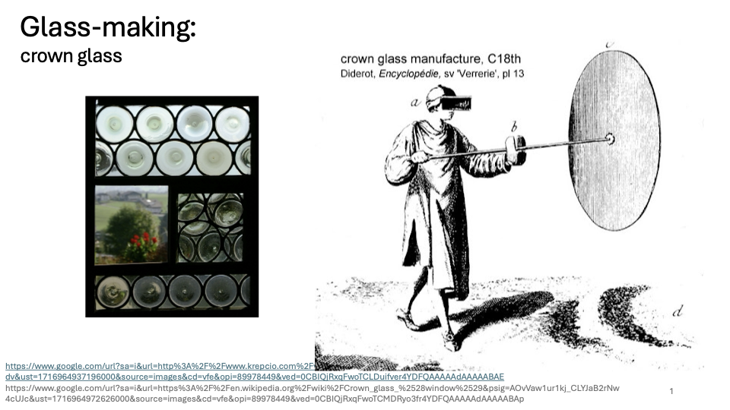

Slide 46
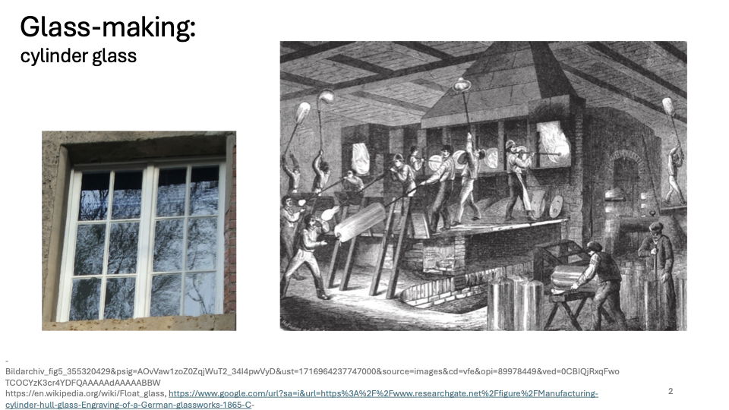

Slide 47


